Slide 1

Insights & Reccomedations
Module 5
BCG – Data Science & Advanced Analytics Virtual Experience Program by Alejandro Cerrilla

Slide 2

Business Understanding & Problem Framing
Create a predictive model that observes the reduced churn rate and determine if the discount percentage is effective.
The parameters we first need to analyze should be:
Churn rate during the liberalization of the energy market in Europe (before & after).
The average client’s bill for PowerCo services during this period.
Date of client's last bill before quitting PowerCo services.
From these variables we will have a certain idea what was the customers churn before the liberalization of the energy market in Europe and the average PowerCo bill for each client. The predictive model will analyze if the discount is a good factor for the churn to decrease.

Slide 3
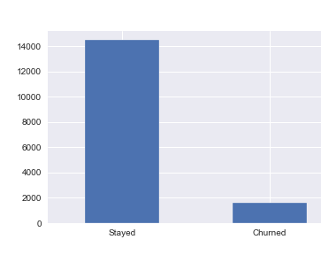
Exploratory Data Analysis & Data Cleaning
Churn data
1. There are no missing values for the Churn Data.
2. Active customers: 14501.
3. Churned customers over the past 3 months: 1595.
4. Customer retention over the past 3 months is 90.09%.
5. Customer attrition over the past 3 months is 9.9%.

Slide 4

Price of Power & energy
Price of energy
The average price of energy for the 1st period is 0.1409
The average price of energy for the 2nd period is 0.0544
The average price of energy for the 3rd period is 0.0307
Price of power
The average price of power for the 1st period is 43.32
The average price of power for the 2nd period is 10.69
The average price of power for the 3rd period is 6.45
We can observe both the price of energy and power decreased over the last 3 periods

Slide 5
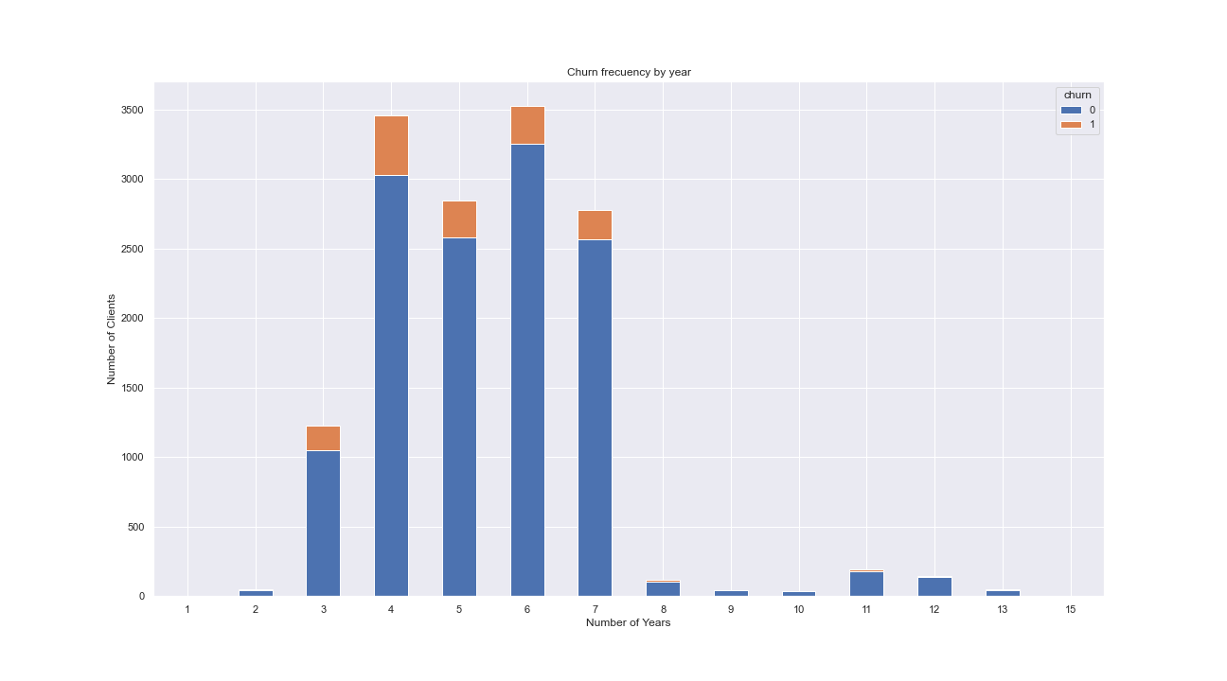
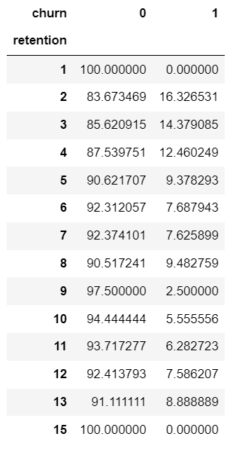
Churn frequency per year
Facts
The average customer lasts 5 years.
The average net margin is $217.98 .

Slide 6
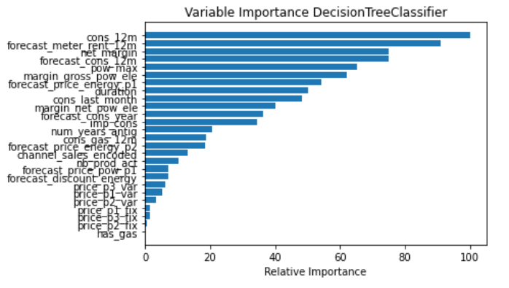
Feature importance
In the feature importance graph above we can see that cons_12m and net_margin are the features that appear the most in our model and we could infere that these two features have a significant importnace in our model.

Slide 7
Conclusion
By analyzing the customer attrition, we suggest to focus on their marketing strategy to improve the customer retention over the first 3 - 7 years (specially years 2 - 4), since this is the period in which customers tend to churn the most. After this period of time, there is a customer churn decrease of almost 9%.
This is important because it may seem that PowerCo is losing a significant number of customers but by improving the customer retention in this critical period of time (years 2 - 4) , the customer churn will eventually decrease. We can appreciate that the percentage of the churned customers in years 2 - 4 has a mean of 13%, while years 5 - 8 have 8%, and after year 8 only 5% of the customers churn.
Our recommendation is to reduce the net margin of the energy subscription for each customer, as the analysis showed that this factor is extremely important for customer retention.

